Slide 1


Sneakers Store
NOSQL FINAL PROJECT
Students
Instructor
Kamila Baimuratova, Trushkina Valeriya
Shynar Akhmetzhanova

Slide 2
Purpose and main objectives
The purpose of this project is to develop an efficient and user-friendly web application for an online sneaker store. The application will allow users to interact with a MongoDB database to manage sneaker objects, enabling them to add, edit, and delete sneaker entries.
# 1
# 2
# 3
Database Design and Management
CRUD Functionality
User Interface and security

Slide 3

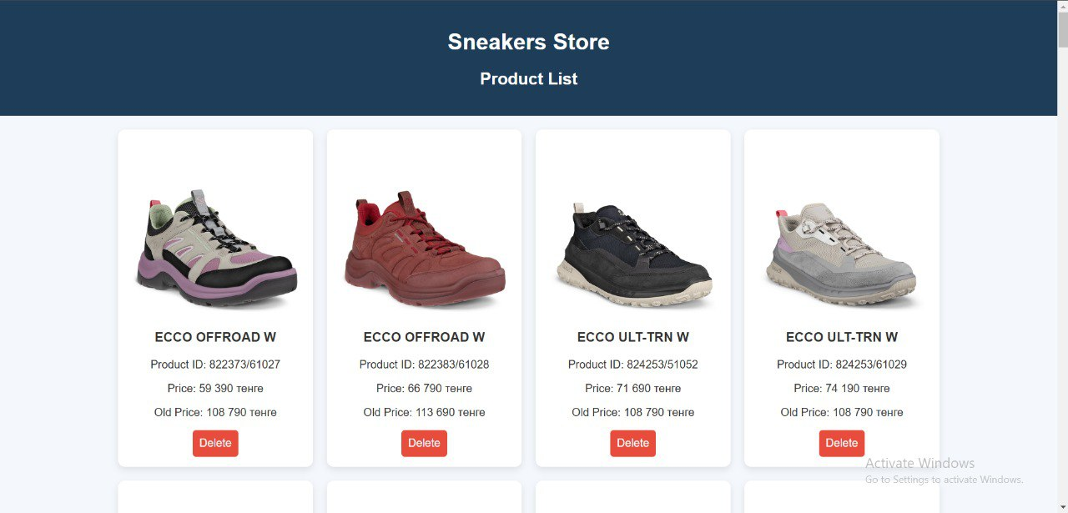
The application is useful for local use as it provides an easy way to manage existing products.
Users can quickly view photos of the models in the database and effortlessly add or edit objects with minimal effort.

Slide 4
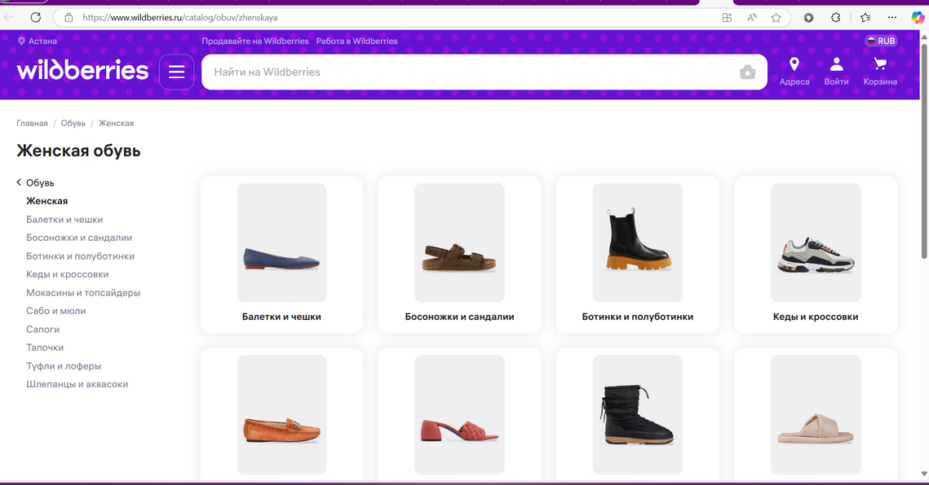
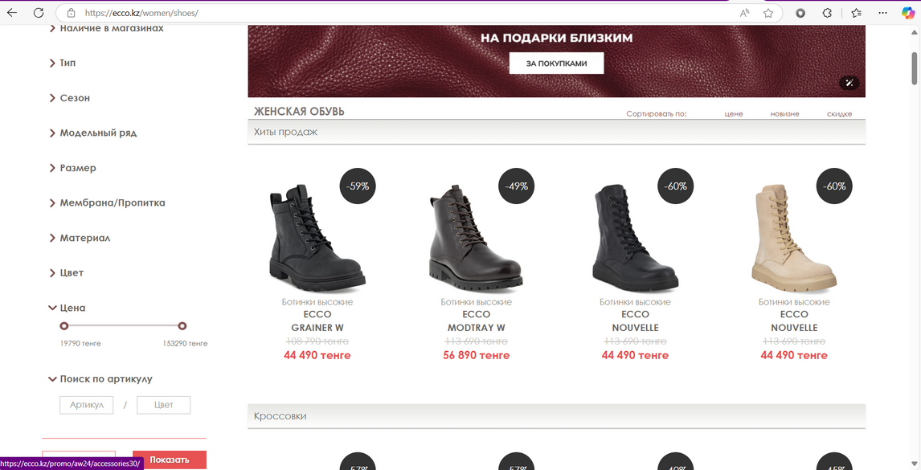
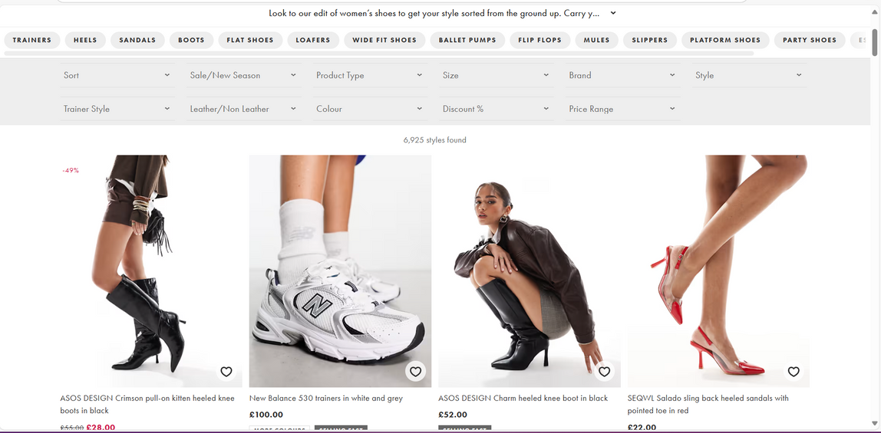
Similar existing applications or websites

Slide 5
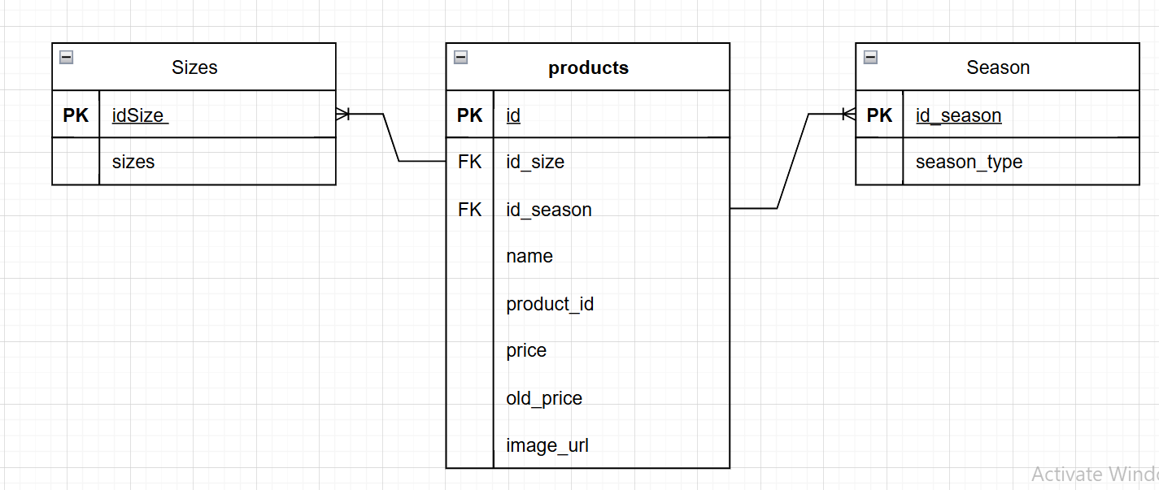
ER diagram

Slide 6
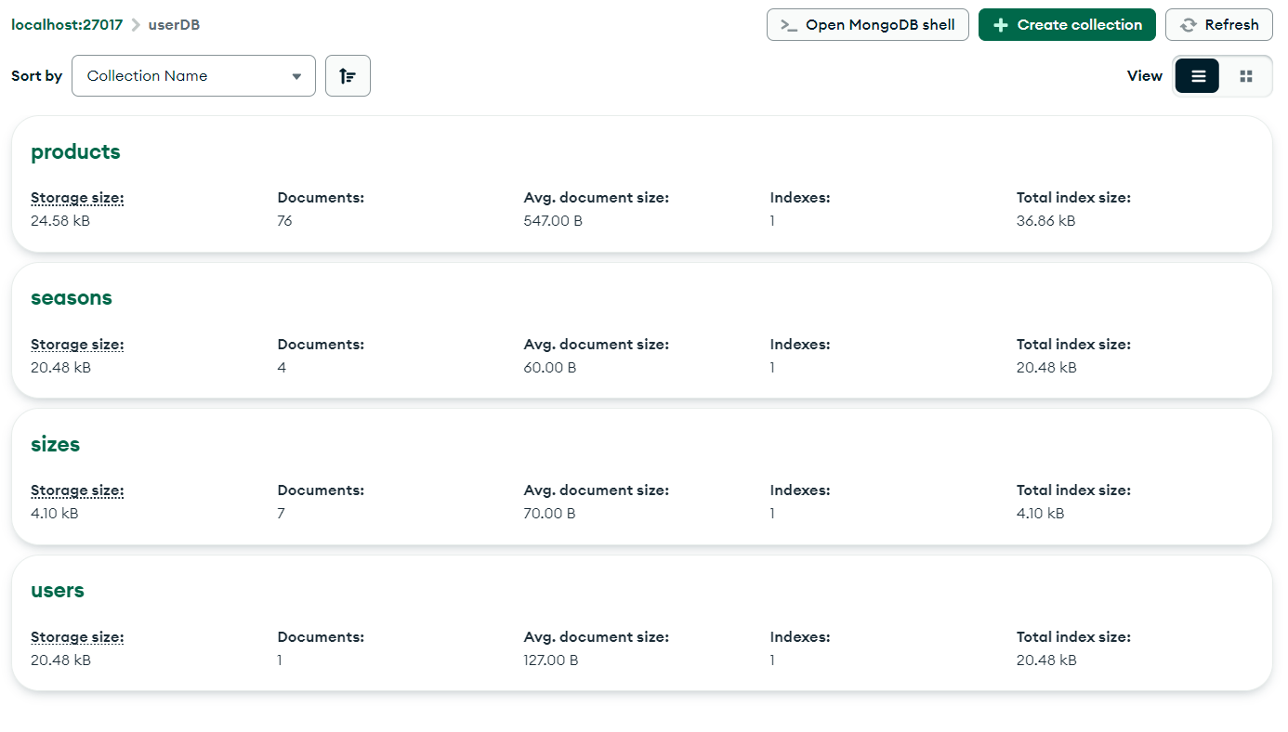
database

Slide 7
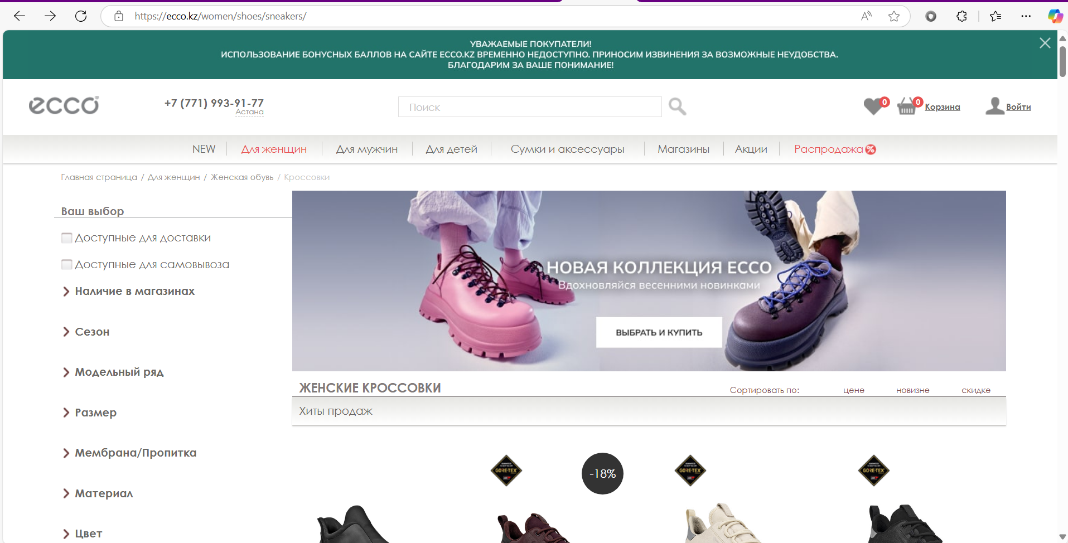
Parsing object

Slide 8
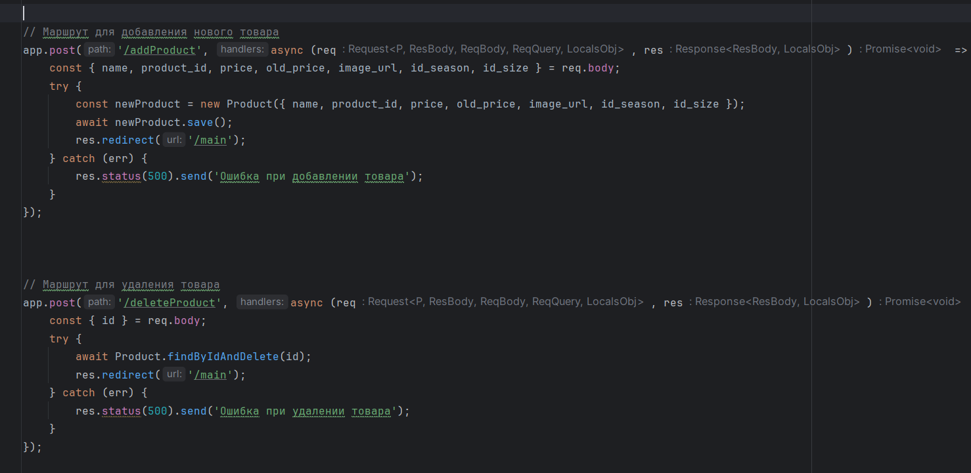
CRUD
CREATE

Slide 9
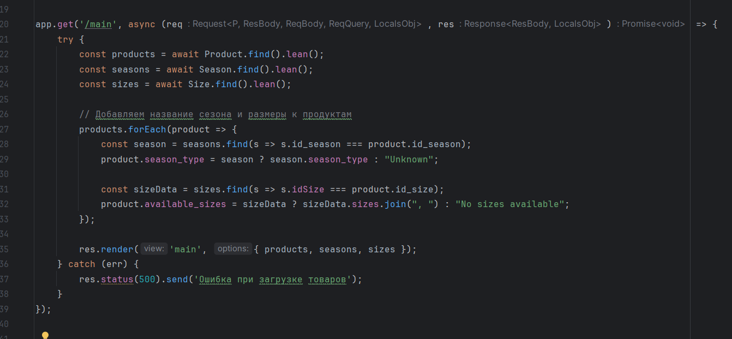
CRUD
READ

Slide 10
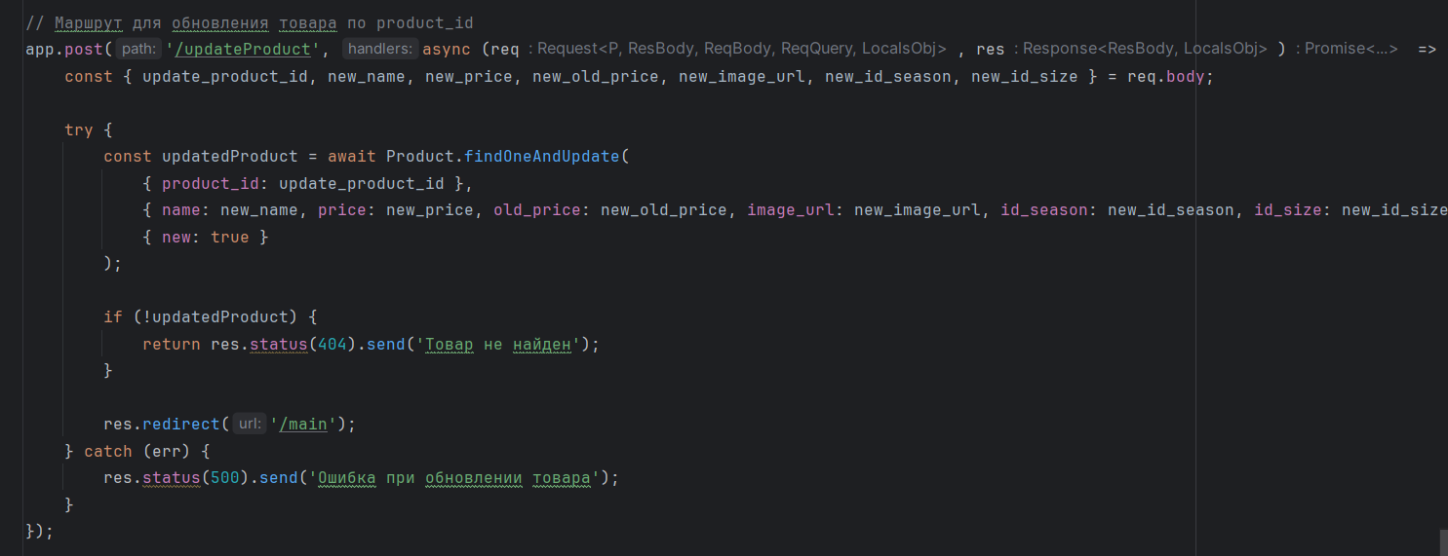
CRUD
UPDATE

Slide 11
CRUD
DELETE

Slide 12
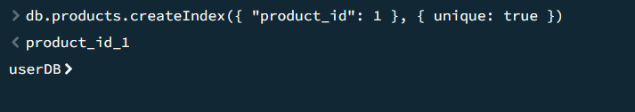
INDEXING

Slide 13
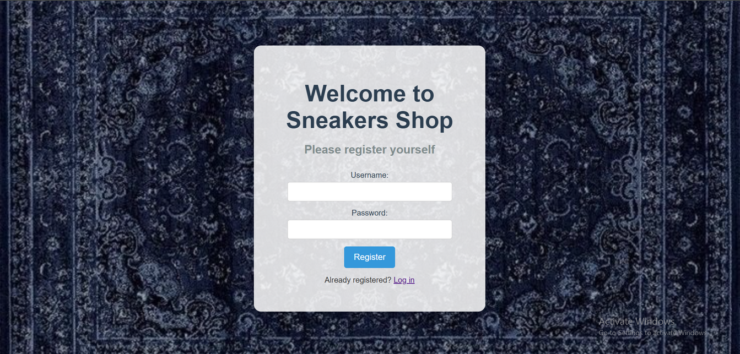
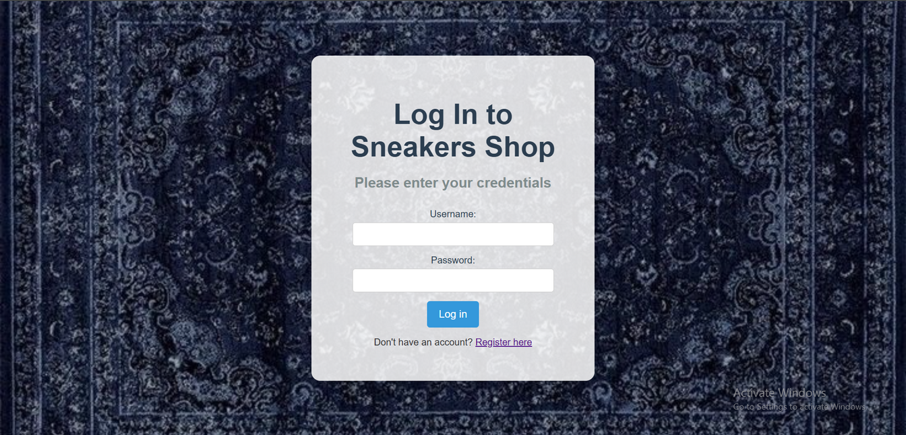
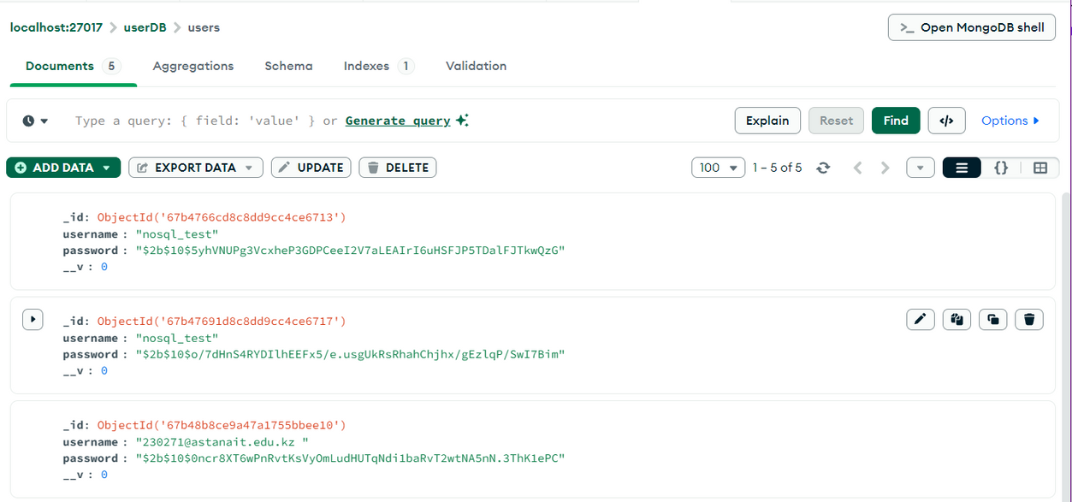
SECURITY

Slide 14
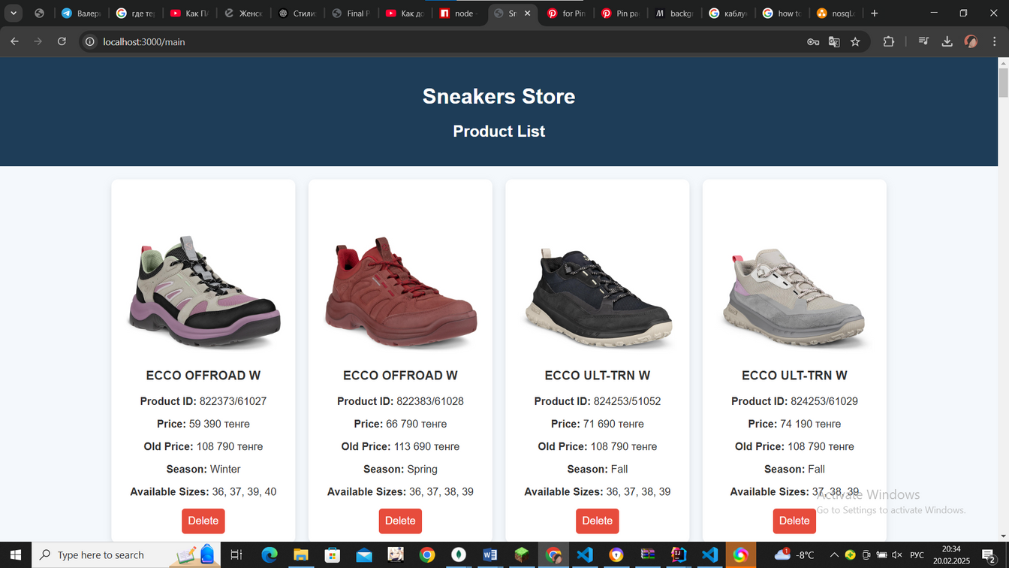
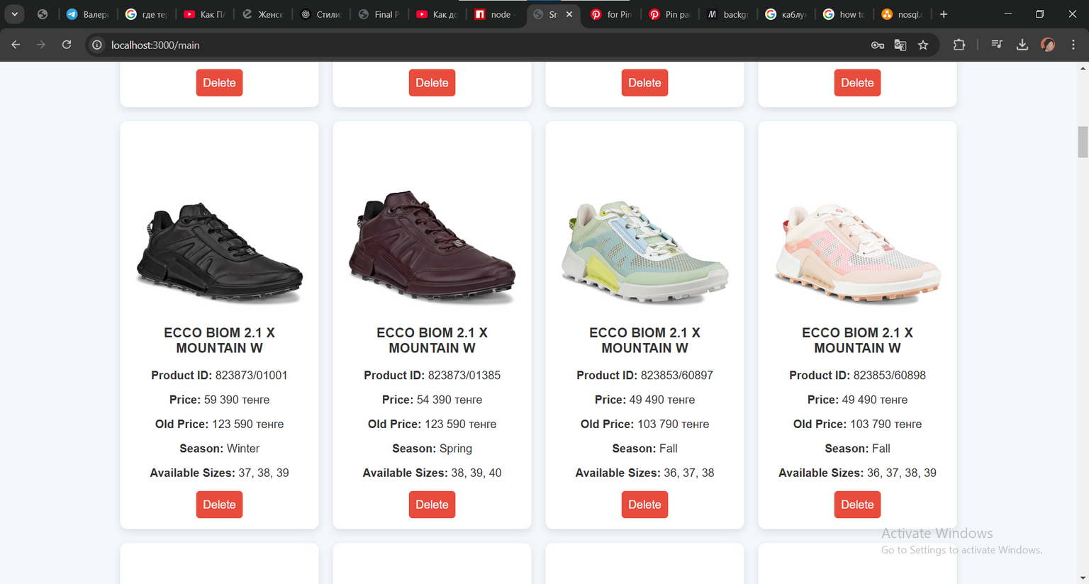

Slide 15
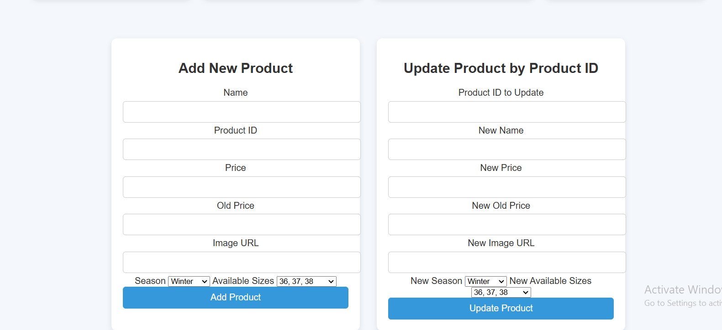

Slide 16
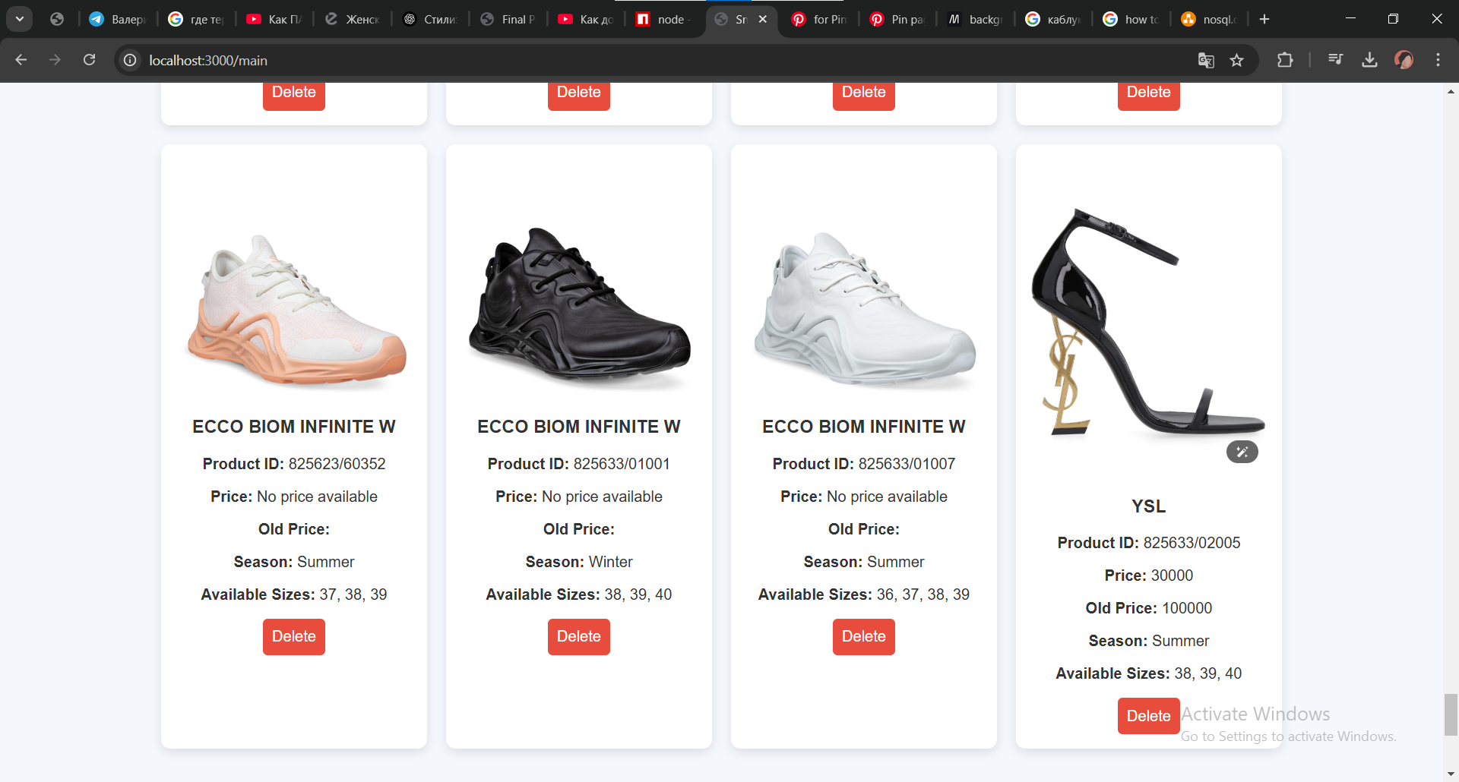

Slide 17
FUTURE RESEARCH
ADD FILTER
KEY FINDINGS
The application simplifies product management by allowing quick edits and additions to the database.
It provides an intuitive interface for easily viewing and updating product details.

Slide 18
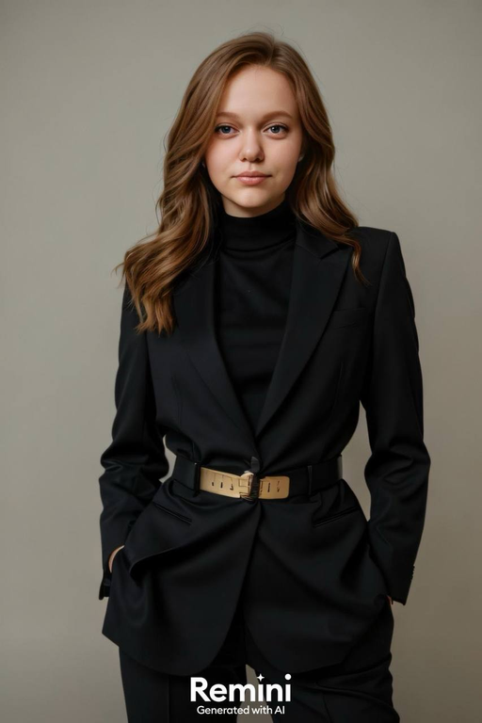

For questions,
reach out to:
Trushkina Valeriya
230271@astanait.edu.kz
Baimuratova Kamila
230170@astanait,edu.kz

